Slide 1
Energy Efficiency and Climate Change
Engagement in Croatia
Zagreb, 2 March 2016

Slide 2
Agenda
      Introduction: EBRD Sustainable Resource Initiative
      EBRD response: integrated programme
        Financial instrument (investment)
        Technical assistance
        Policy dialogue support
      Case studies
2 March 2016
2
Notes:
Participants discuss options to bring action to fruition (where are the real opportunities), mobilize finance, technology and capacity and ways of overcoming barriers (what is happening on financing and policy fronts).
What policy would be effective to achieve buildings energy efficiency before 2020?
scalable, replicable and transformative actions
What are the barriers to implementing those actions?
How to overcome/address those barriers?

Slide 3
EBRD Climate Actions through its
Sustainable Resource Initiative
The EBRD addresses the issue of climate change mitigation and adaptation through its Sustainable Resource Initiative (SRI).
The SRI promotes efficiency and innovation in energy (SEI), water and materials.
Sustainable Energy Initiative
Materials Efficiency
Water Efficiency
Between 2006 and 2014, EUR 16.4 billion of SRI finance was invested in 926 projects, with 69.6 million tonnes of CO₂ eq/y of emission reductions.
RELEVANCE OF THE BUILDING SECTOR:
Building sector is the largest energy consumer in the EBRD region (around 40% of the final energy consumption).
Building sector has been one of the key priority areas for EBRD’s climate actions since 2012.
2 March 2016
3
Notes:
Recognizing this, the EBRD launched the Sustainable Energy Initiative (SEI) in 2006 with the aim of scaling up sustainable energy investments in the EBRD’s regions, improving the business environment for sustainable investments and removing key barriers to market development.

Slide 4
EBRD Investments in Building’s Energy Efficiency
  SRI investment in buildings since 2006 (EUR in million)
The EBRD invested over EUR 1 billion in building‘s energy efficiency since 2008.
Intermediated financing: around 83,000 buildings EE projects were financed through 107 local financial institutions across 20 countries.
EUR 93 million
EUR 328 million
EUR 535 million
  By financing channel: intermediated or direct (EUR in million)
Intermediated finance (SEFF) | 300
Direct EBRD financing | 700
Agribusiness | 180
Transport | 160
Municipal & Env Infra | 150
Property and Tourism | 160
Energy Service Companies | 27
Manufacturing and Services | 20
Primary energy savings: 4,318 GWh/year
Carbon reductions: > 1.1 million tons of CO₂ per year
2 March 2016
4
Notes:
SRI composition (indicative):
95% energy efficiency
More than 4% water efficiency
Less than 1% of waste minimisation and sustainable materials (focus since 2014)

Slide 5
Barriers to Energy Efficiency and
Climate Change
  Market actors in the supply chain
  High transaction costs due to small project size and wide range of stakeholders.
  Lack of technical expertise for the EE assessment/appraisal in buildings.
  Information asymmetries.
  Misconceptions about technical risks and financial benefits and low awareness.
  Financial sector
  Lack of specific and structured financing instruments.
  High perceived risk (technical, financial) and low awareness.
2 March 2016
5
Notes:
Highly fragmented sectors
Large number of small size projects
Wide range of stakeholders – property owners, tenants, municipalities, condominiums

Slide 6
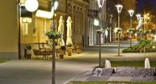

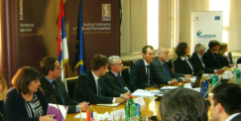
EBRD Response to the Barriers
  EBRD integrated programme to address a range of barriers at the same time
      Blend concessional finance from donors with EBRD finance through policy dialogue, capacity building and grant incentives.
      EBRD finance + concessional finance (grants) + technical assistance + policy support
  Well structured financing instruments for the effective delivery
PROJECTS AND INVESTMENTS
Projects across SEI areas
TECHNICAL ASSISTANCE
POLICY DIALOGUE
Technical assistance to overcome barriers
Working with governments to support
2 March 2016
6

Slide 7




Resource Efficiency Measures (“REMs”)
Priority areas of focus for REMs identification:
Energy saving opportunities
Energy efficiency on process
Energy efficiency on utilities
Renewable energy
Greenhouse gas (CO₂-eq Emission Reductions)
Reduction of fresh water consumption
Water recycling/harvesting
Water distribution network (pumping, leaks detection, …)
Zero liquid discharge technologies
Advanced water/wastewater treatment
Metering and Implementation & Compliance
Water saving opportunities
Waste recovery / recycling opportunities
Waste mapping
Reduction of waste streams
Internal reuse
By-products recovery
Integrated resource efficiency opportunities
Process integration/optimisation (production yield increase, ...)
Logistics management systems, value chain
Integrated resource management systems
2 March 2016
7
7
Notes:
GHG – A greenhouse gas

Slide 8
Sustainable Energy Financing Facilities (“SEFFs”) in Numbers
19 countries
84 Participating Financial Institutions
EUR 3.4 billion EBRD financing
70,107 investments
EUR 1.7 billion sustainable energy investments
EUR 2.4 billion provided to Participating Financial Institutions
12 million MWh/annum saved
4.2 million CO₂ emissions/annum avoided
16 Donors
2 March 2016
8

Slide 9

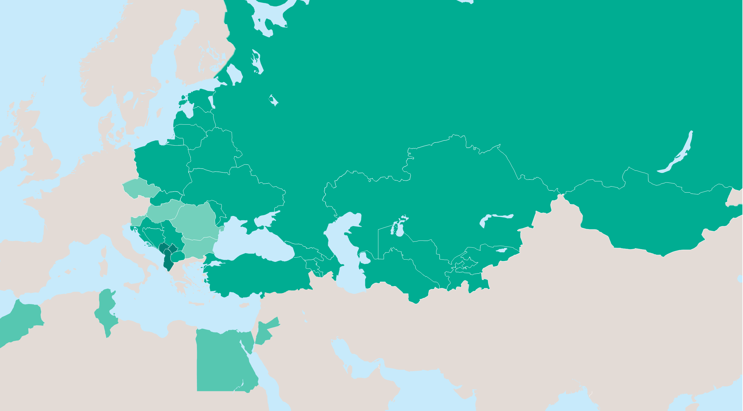
EU/EBRD Western Balkans Sustainable Energy Financing Facility II – WeBSEFF II
  By end of March 2015, all the PFIs have signed the loan agreements with EBRD and the whole Facility has been activated in total amount of
  EUR 92 million
  Financial structure
  Credit line EUR 92 million
  Incentives EUR 11.2 million
  Technical cooperation EUR 3.3 million
  Progress
  9 PFIs have joined the WeBSEFF II
  By end of December 2015, 185 projects signed (loan amount of EUR 49,620,414 )
  32 projects in the pipeline (loan amount of EUR 21,433,571 )
  CO₂ emissions saved: 92,837 tonnes/year
No. of projects signed
(and in the pipeline)
14 (23)
17 (3)
20(28)
5(2)
2 March 2016
9

Slide 10
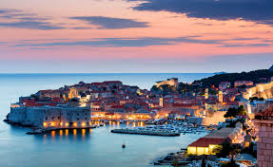
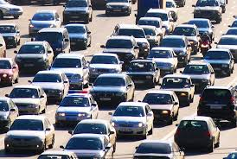
Western Balkans
Sustainable Energy Financing Facility II
Through 185 sub-projects and investments in amount of EUR 49.62 million
in 2.5 years, following saving were achieved:
Primary energy savings: 327 GWh/y
buildings energy consumption
of the city of ~25,000 inhabitants
Carbon reductions: 92,837 tonnes of CO₂ /y.
~13,600 passenger cars in 1 year
2 March 2016
10

Slide 11
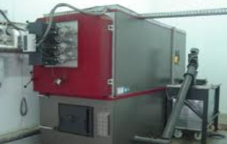
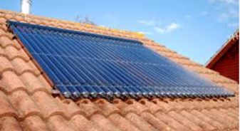

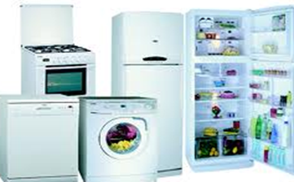
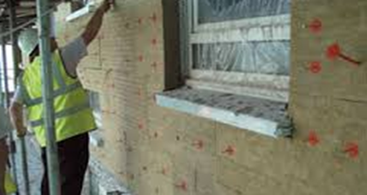
New Project - Croatia Residential Sustainable Energy Financing Facility (“CroSEFF”)
Established in 2015 EUR 60 million Program via Partner Financial Institutions for investments in residential sustainable energy projects.
This is the FIRST dedicated residential SEFF operation in Croatia among all IFIs.
TC package EUR 1.8 million includes:
Implementation support: support including marketing and general awareness raising activities; capacity building for Partner Financial Institutions.
Residential SEFF website: made available eligibility criteria, more than 1,000 items of eligible equipment, screened vendors and suppliers of recommended equipment, optimal packages of measures, useful installation tips, an energy savings calculator, case-studies and technology brochures.
2 March 2016
11

Slide 12
Benefits for Sub-borrowers
Energy Efficiency in
Residential Sector
Sustainability of investment
Reduced energy bill in long-term perspective
Property value increase
Improved quality of life for homeowners
2 March 2016
12

Slide 13

Energy Efficiency in Food Sector
Case Studies: Atlantic Group and Podravka
    Atlantic Group
    Implementation of energy efficiency and water efficiency investments following Energy audit financed by the EBRD technical support funds.
    EUR 10 million energy efficiency loan which included improvements of the production processes and its main auxiliaries, such as upgrade of heating furnaces and the main power distribution systems.
    Supporting young people employment in the recessionary environment.
    Detailed strategy and the restructuring plan: labour restructuring, launch of new products, identification of the energy efficiency investments.
    Podravka
      Introduction of sustainability reporting and supply chain management.
      Bank’s loan of EUR 9.9 million for increasing the Company’s energy savings and thus contributing to its profitability and overall competitiveness.
      To support the efficiencies, the Bank in the agreement with the Company has commissioned an external energy efficiency audit at its key production facilities which identified investments creating energy savings.
2 March 2016
13

Slide 14
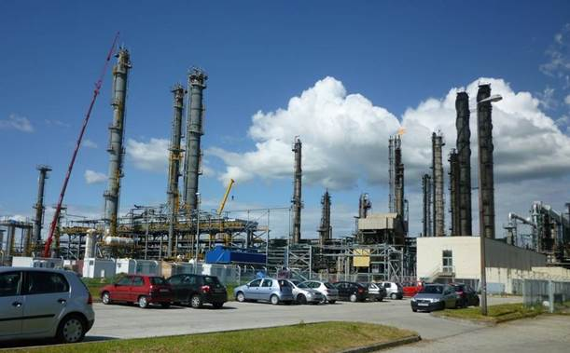
Energy Efficiency in National Resources
Case Study: INA, Refineries Modernisation
CLIENT
    INA, a leading oil and gas company, owns two medium-sized refineries in Croatia.
PROJECT
    Investment programme reducing fuel loss and improving energy performance at INA’s two refineries.
    Finance for advanced refining technologies for the production of EU quality products (EURO V fuels).
    Implementation of an environmental remediation programme.
FINANCIAL STRUCTURE
  EBRD loan EUR 150 million
  of which SEI EUR 68 million
  INA’s own funds EUR 271 million
  Total project value EUR 481 million
TECHNICAL ASSISTANC & EXPECTED IMPACT
  Energy savings: 2,600,000 MWh/year
  Emission reductions: over 1,000,000 tCO₂/year
2 March 2016
14

Slide 15
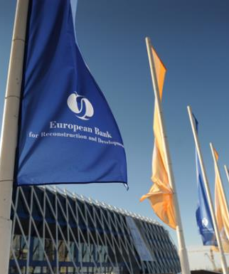
Contacts
For all further enquiries, please contact:
Zagreb Resident Office Miramarska 23, 5th Floor 10 000 Zagreb Croatia t: + 385 1 6000 310
Project Enquiries Business Development department t: + 44 20 7338 7168 e: newbusiness@ebrd.com
Media Enquiries EBRD Press Office t: + 44 20 7338 7805 e: press@ebrd.com
EBRD, One Exchange Square London, EC2A 2JN United Kingdom www.ebrd.com http://www.ebrd.com/croatia.html
2 March 2016
15

